Slide 1


Slide 2

Who am I?

Slide 3

Here in CSE,VU……
Hired Faculty/ Adjunct Faculty Since Spring 2022
My Origin……
Associate Professor
Dept. of Information and
Communication Engineering.
My Education…..
B.Sc. in ICE, RU (2008)
M.Sc. in ICE, RU (2009)
Ph.D. in ICS, Saitama Uni, JP
(2016)
@ RU since 2003
DR. MD. GOLAM RASHED

Slide 4
More details about me
@
http://www.ru.ac.bd/ice
Contact me through
Mobile: +88-01717-515008
Email: golamrashed@ru.ac.bd
golamrashed.ru@gmail.com
DR. MD. GOLAM RASHED

Slide 5

CSE 1201
(Data Structures)
Lecture on
Chapter-1: Introduction
By
Dr. M. Golam Rashed
(golamrashed@ru.ac.bd)
Department of Computer Science and Engineering (CSE)
Pundra University of Science and Technology, Bogra-Bangladesh

Slide 6
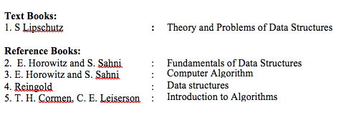
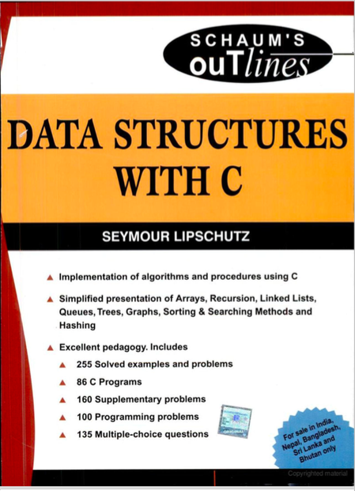
CSE 2103
©️ Dr. Md. Golam Rashed, Assoc. Professor, Dept. of ICE, RU
ICE 2231/ Introductory Class

Slide 7
CSE 2103
120
75
55
Seymour Lipschutz

Slide 8
?
CSE 2103
Data are simple values or set of values.
Data item refers to a single unit of values
Data items that are divided into sub-items are called group items.
For example:
An employee’s name may be divided into three sub item…..
First name
Middle name
Last Name
But, NID number would be normally be treated as a single item

Slide 9
CSE 2103
120 km in distance
75 kgs in weight
55 cm in height
Writer: Seymour Lipschutz

Slide 10
Collection of data are frequently organized into a
Hierarchy of fields
Records
Files
CSE 2103
Entity?
An entity is something that has certain ATTRIBUTE or PROPERTIES which may be assigned VALUES.
may be numeric or non-numeric
ATTRIBUTE | NAME | Age | Sex | Height | NID
Values | Jhon | 30 | Male | 65 cm | 27642847

Slide 11
Entity Set?
CSE 2103
Entities with similar ATTRIBUTES form entity set.
Example:
All the employee in an organization
All the students of any department.
Each attribute of an entity set has a range of values

Slide 12
Information?
CSE 2103
Processor
Data
Information
Processed dare are usually called information

Slide 13
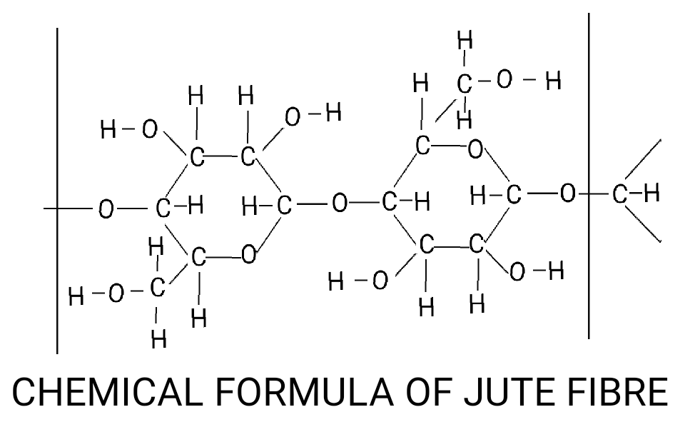
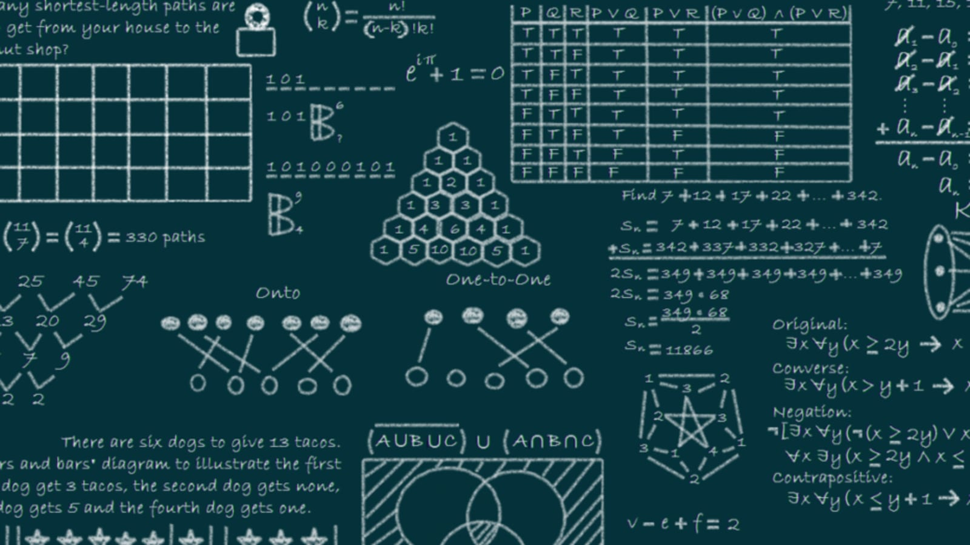
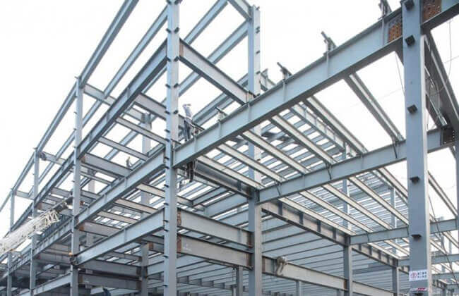
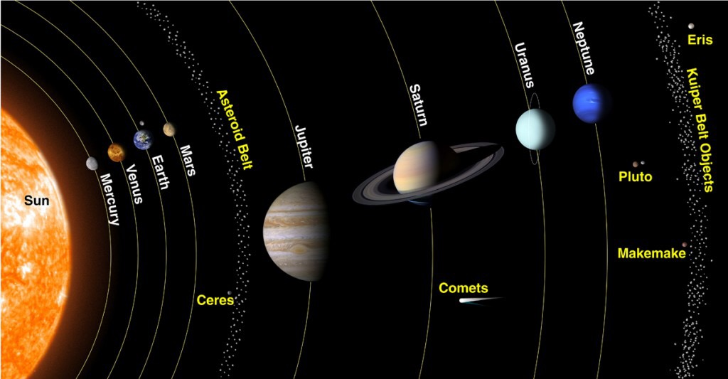
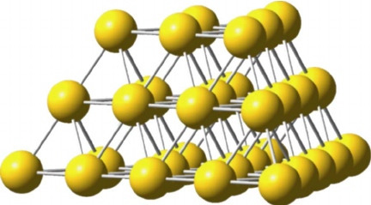
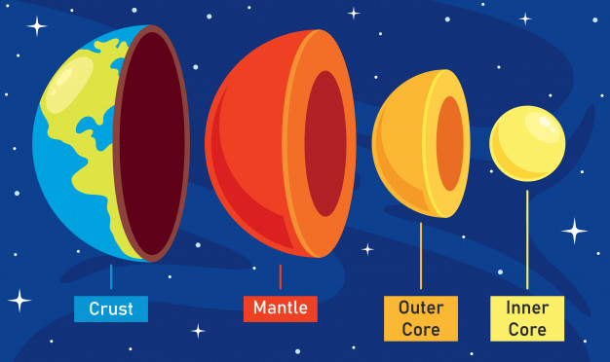
CSE 2103

Slide 14
Data Structure?
CSE 2103
Data may be organized in many different ways.
The logical or mathematical model of a particular organization of data is called a data structure
Particular data model depends on TWO consideration:
It must be rich enough in structure to mirror the actual relationships of the data in real world.
The structure should be simple enough that can be efficiently process the data when necessary.

Slide 15
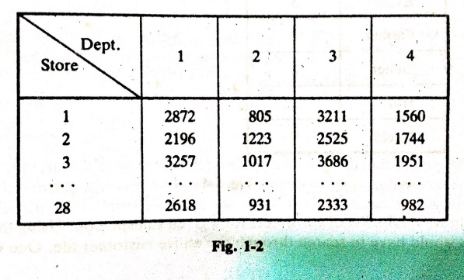
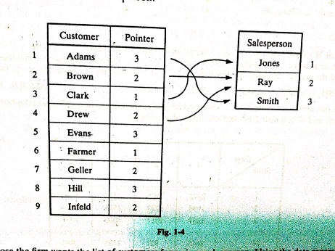
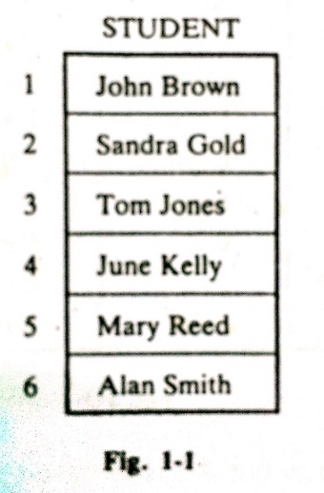
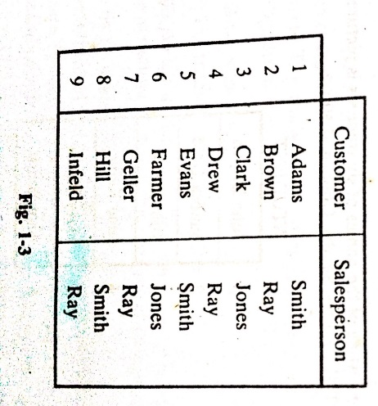
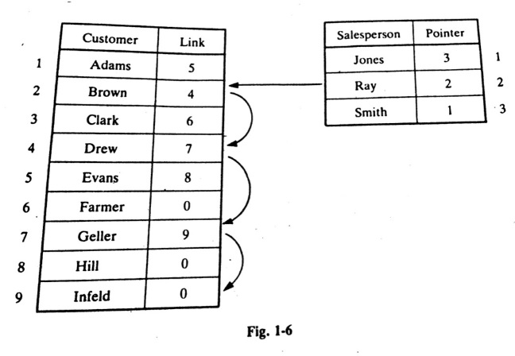
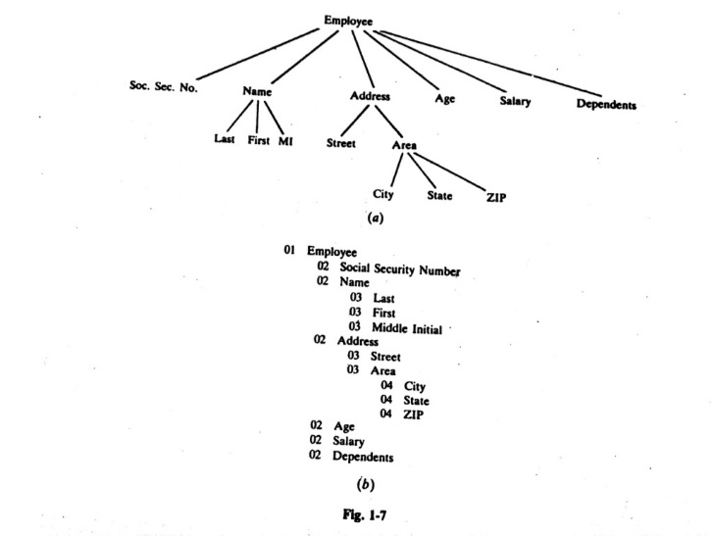
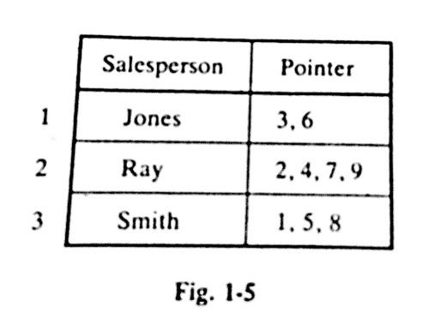
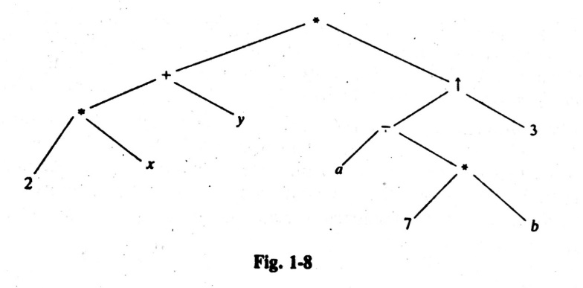
Some Data Structure
CSE 2103
Two D array
Linked List
One D array
(2x+y)(a-7b)³
Hierarchical

Slide 16


Data Structure: Array
Simplest types of data structure
CSE 2103
One dimensional array /Linear
Two dimensional Array

Slide 17
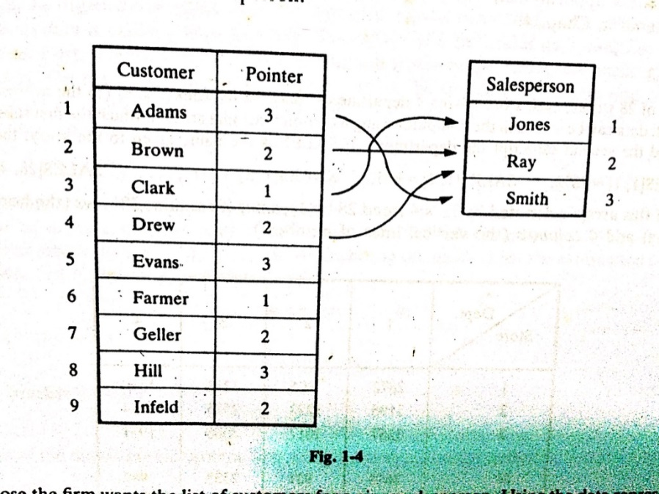


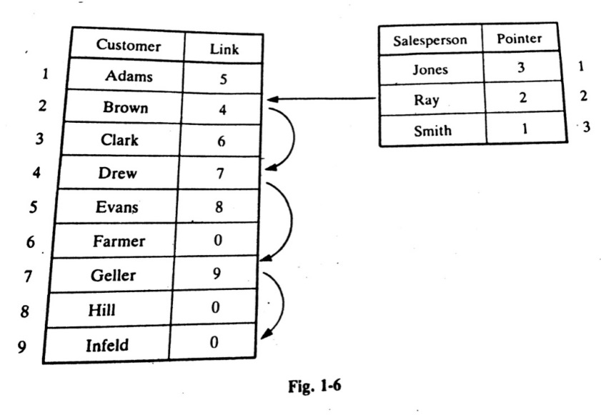
Data Structure: Link List
CSE 2103
Advantages: An integer used as a pointer requires less space than a name. Hence this representation saves spaces, if there are hundreds of customers for each salesman

Slide 18


Data Structure: Tree
CSE 2103
Data frequently contain a hierarchical relationship between various elements. The data structure reflects this relationship is called a rooted tree graph or simply a tree

Slide 19
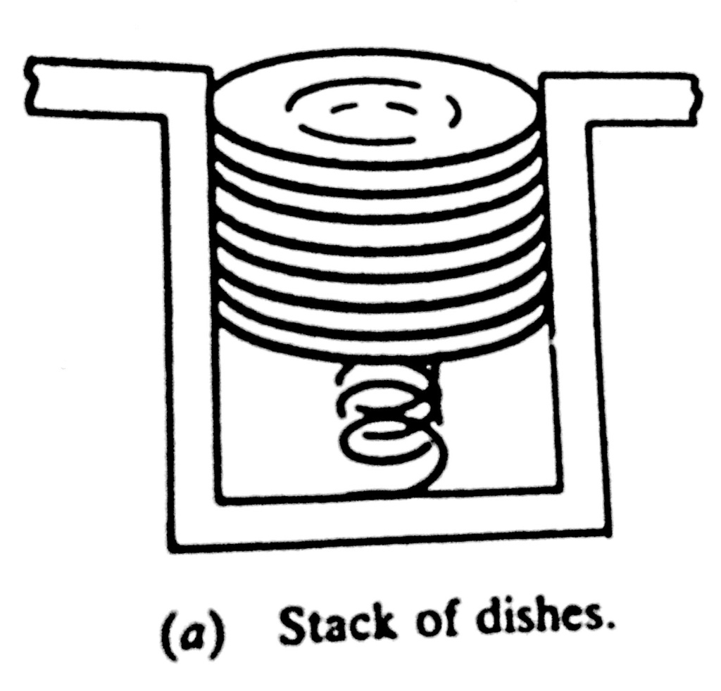
Data Structure: Stack
CSE 2103
LIFO

Slide 20
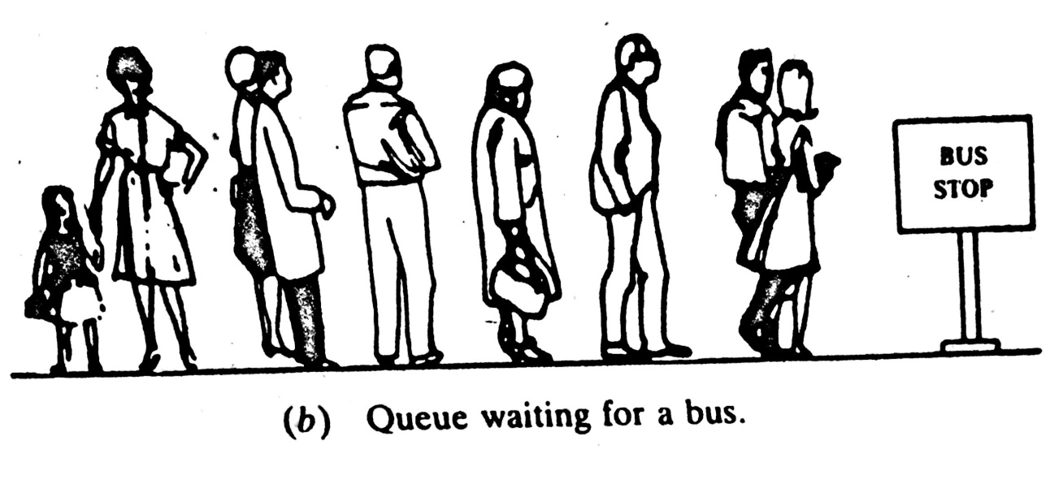
Data Structure: Queue
CSE 2103
FIFO

Slide 21
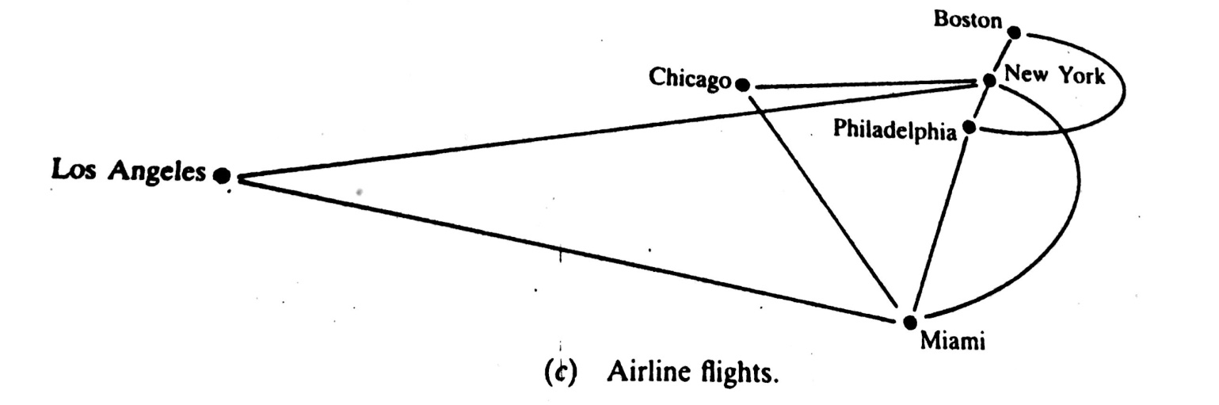
Data Structure: Graph
CSE 2103

Slide 22
Data Structure Operations
CSE 2103
The data appearing in our data structure are processed by mean of certain operations.
The most frequently used of these operation are:
Traversing
Searching
Inserting
Deleting
Update
Sorting
Merging

Slide 23
Data Structure Operations
CSE 2103
Accessing each record once so that certain items in the record may be processed (Visit).
Example:
An organization contains a membership file in which each record contains data for a given member:
Name Address Tel. Number Age Sex
Suppose the organization wants to announce through a mailing.
Suppose one wants to find the name of all members in a certain area.
Operation: Traversing

Slide 24
Data Structure Operations
CSE 2103
Finding the location of the record with a given key value, or finding the locations of all records which satisfy one or more condition.
Example:
An organization contains a membership file in which each record contains data for a given member:
Name Address Tel. Number Age Sex
Suppose one wants to obtain address for a given name.
Operation: Searching

Slide 25
Data Structure Operations
CSE 2103
Adding a new record to the structure
Example:
An organization contains a membership file in which each record contains data for a given member:
Name Address Tel. Number Age Sex
Suppose a new person joins the organization.
Operation: Inserting

Slide 26
Data Structure Operations
CSE 2103
Removing a record from the structure
Example:
An organization contains a membership file in which each record contains data for a given member:
Name Address Tel. Number Age Sex
Suppose a Member dies.
Operation: Deleting

Slide 27
Data Structure Operations
CSE 2103
Changing items in the record with the new data
Example:
An organization contains a membership file in which each record contains data for a given member:
Name Address Tel. Number Age Sex
Suppose a member has moved and has a new address and telephone number.
Operation: Updating

Slide 28
Data Structure Operations
CSE 2103
Arranging the record in some logical order (e.g. alphabetically according to some NAME key)
Example:
An organization contains a membership file in which each record contains data for a given member:
NAME Address Tel. Number Age Sex
Suppose One wants to obtain all the members list according to alphabetical order of their family name.
Operation: Sorting

Slide 29
Data Structure Operations
CSE 2103
Combining the records in two different sorted files into a single sorted file.
Example: Exam Answer Script
Operation: Merging

Slide 30
Application Domains of Data Structures
CSE 2103
Data structures are like the filing cabinets and organizers of the computer world.
They provide efficient ways to store, organize, and access data.
Their applications are vast and span across various domains:
Software Development:
Artificial Intelligence and Machine Learning:
Networking and Routing:
Other Applications:

Slide 31
Application Domains of Data Structures
CSE 2103
Software Development:
Arrays: The foundation for storing collections of similar data items, used in functions, lists, and tables.
Linked Lists: Useful for dynamic data (frequently changing size) like managing browser history or implementing undo/redo functionalities.
Stacks: LIFO order, perfect for function calls, backtracking algorithms, and implementing the "undo" functionality.

Slide 32
Application Domains of Data Structures
CSE 2103
Software Development:
Queues: FIFO order, ideal for managing printer jobs, task scheduling, and handling requests in servers.
Trees: Hierarchical organization for efficient searching and sorting, used in file systems, contact management, and decision trees in AI.
Graphs: Model relationships between data points, used in social networks, navigation apps (finding shortest paths), and recommendation systems

Slide 33
Application Domains of Data Structures
CSE 2103
Artificial Intelligence and Machine Learning:
Trees: Decision trees for classification tasks, and kd-trees for efficient nearest neighbor search in high-dimensional data.
Graphs: Knowledge graphs to represent entities and relationships, used in natural language processing and recommender systems.
Networking and Routing:
Trees: Spanning trees to find optimal paths in networks, and prefix trees for efficient IP address routing.
Graphs: Modeling network topologies, routing algorithms, and network traffic analysis.

Slide 34
Application Domains of Data Structures
CSE 2103
Other Applications:
Geographic Information Systems (GIS):
Spatial data structures like quadtrees and R-trees for efficient storage and retrieval of geographic data.
Financial and Trading Systems: Priority queues for order processing and maintaining order books in stock exchanges.

Slide 35
Application Domains of Data Structures
CSE 2103
Their applications are vast and span across various domains:
Software Development:
Artificial Intelligence and Machine Learning:
Networking and Routing:
Other Applications:

Slide 36
Application Domains of Data Structures
CSE 2103
Their applications are vast and span across various domains:
Software Development:
Artificial Intelligence and Machine Learning:
Networking and Routing:
Other Applications:

Slide 37
Application Domains of Data Structures
CSE 2103
Their applications are vast and span across various domains:
Software Development:
Artificial Intelligence and Machine Learning:
Networking and Routing:
Other Applications:

Slide 38
Real life Applications of Data Structures
CSE 2103
Data structures are the fundamental building blocks for organizing and storing data efficiently in computer programs.
They play a crucial role in various aspects of our daily lives, often working behind the scenes to ensure things run smoothly.
Here are some real-world applications of common data structures:
Arrays: Imagine the leaderboard in a video game. An array can efficiently store the scores of all players, allowing for easy ranking and retrieval. Similarly, phone contact lists and online shopping carts can be implemented using arrays.

Slide 39
Real life Applications of Data Structures
CSE 2103
Queues: Queues follow a first-in-first-out (FIFO) principle, mimicking real-life waiting lines. They are used in managing tasks like printing jobs, handling website traffic, and processing music playlists in media players.
Stacks: Stacks function in a last-in-first-out (LIFO) manner. A classic example is the "undo" function in many software programs, which utilizes a stack to track the last performed actions and facilitate easy reversal.

Slide 40
Real life Applications of Data Structures
CSE 2103
Trees: Think of your family tree - a hierarchical structure that represents relationships. Similarly, computer trees organize data in a parent-child fashion. They are used for efficient searching and indexing in databases, like the directory structure on your computer or the way DNS (Domain Name System) translates website addresses.
Graphs: Social media platforms like Facebook can be visualized as graphs, where users are nodes and connections between them are edges. Graphs are also used in route planning applications (like GPS) to model road networks and find optimal paths.

Slide 41
Algorithms ?
CSE 2103
An algorithm is a well-defined list of step for solving problem.
The efficiency of an algorithm is obtained by measuring the TIME and SPACE it uses.

Slide 42
Algorithms Notation
CSE 2103
(Largest Element in Array) A nonempty array DATA with N numerical values is given. This algorithm finds the location LOC and the value MAX of the largest element of DATA. The variable K is used as counter.
Step 1. [Initialize] Set K:=1, LOC:=1 and MAX := DATA[1].
Step 2. [Increment counter.] Set K:=K+1.
Step 3. [Test counter.] If K>N, then:
Write: LOC, MAX, and Exit.
Step 4. [Compare and update.] If MAX<DATA[K], then:
Set LOC:=K and MAX := DATA[K].
Step 5. [Repeat loop.] Go to Step 2.

Slide 43
Algorithms Notation
(Largest Element in Array) A nonempty array DATA with N numerical values is given. This algorithm finds the location LOC and the value MAX of the largest element of DATA. The variable K is used as counter.
Step 1. [Initialize] Set K:=1, LOC:=1 and MAX := DATA[1].
Step 2. [Increment counter.] Set K:=K+1.
Step 3. [Test counter.] If K>N, then:
Write: LOC, MAX, and Exit.
Step 4. [Compare and update.] If MAX<DATA[K], then:
Set LOC:=K and MAX := DATA[K].
Step5. [Repeat loop.] Go to Step 2.
The Steps of the algorithm are executed one after the other, beginning with Step 1
Control may be transferred to Step n of the algorithm by the statement “Go to Step n”
If several statements appear in the same step, e.g.,
Set K:=1, LOC:=1 and MAX := DATA[1].
then they are executed from LEFT TO RIGHT
The algorithm is completed when the statement
Exit. Is encountered.

Slide 44
Algorithms Notation
CSE 2103
(Largest Element in Array) A nonempty array DATA with N numerical values is given. This algorithm finds the location LOC and the value MAX of the largest element of DATA. The variable K is used as counter.
Step 1. [Initialize] Set K:=1, LOC:=1 and MAX := DATA[1].
Step 2. [Increment counter.] Set K:=K+1.
Step 3. [Test counter.] If K>N, then:
Write: LOC, MAX, and Exit.
Step 4. [Compare and update.] If MAX<DATA[K], then:
Set LOC:=K and MAX := DATA[K].
Step5. [Repeat loop.] Go to Step 2.
The [comment] will usually appear at the beginning or the end of the step.
Variable names will use capital letters as in MAX and DATA.
Single-letter names of variables used as counters or subscripts will also be capitalized in the algorithms (K and N, for example).

Slide 45
Algorithms Notation
CSE 2103
(Largest Element in Array) A nonempty array DATA with N numerical values is given. This algorithm finds the location LOC and the value MAX of the largest element of DATA. The variable K is used as counter.
Step 1. [Initialize] Set K:=1, LOC:=1 and MAX := DATA[1].
Step 2. [Increment counter.] Set K:=K+1.
Step 3. [Test counter.] If K>N, then:
Write: LOC, MAX, and Exit.
Step 4. [Compare and update.] If MAX<DATA[K], then:
Set LOC:=K and MAX := DATA[K].
Step5. [Repeat loop.] Go to Step 2.
Assignment statements will use the dots-equal notation (:=).
For example, MAX := DATA[1]. ( Some time ← or = is used for this operation
Data may be input and assigned to variables by means of a Read statement
For example, Read: Variable names
Similarly, data in variable may be output by mean of a Write or Print statement
For example, Write: Message and / or variable names.

Slide 46
Complexity of Algorithms
CSE 2103
The complexity of an algorithm is the function which gives the running time and/or space in terms of the input size.
In order to compare algorithms, we must have some criteria to measure the efficiency of a algorithm.
Suppose M is an algorithm, and suppose n is the size of the input data.
The TIME and SPACE used by the algorithm M are the two main measures for the efficiency of M.
The TIME is measured by counting the number of key operation-in sorting and searching algorithms. (the # of comparison)
The SPACE is measured by counting the maximum of memory needed by the algorithm

Slide 47
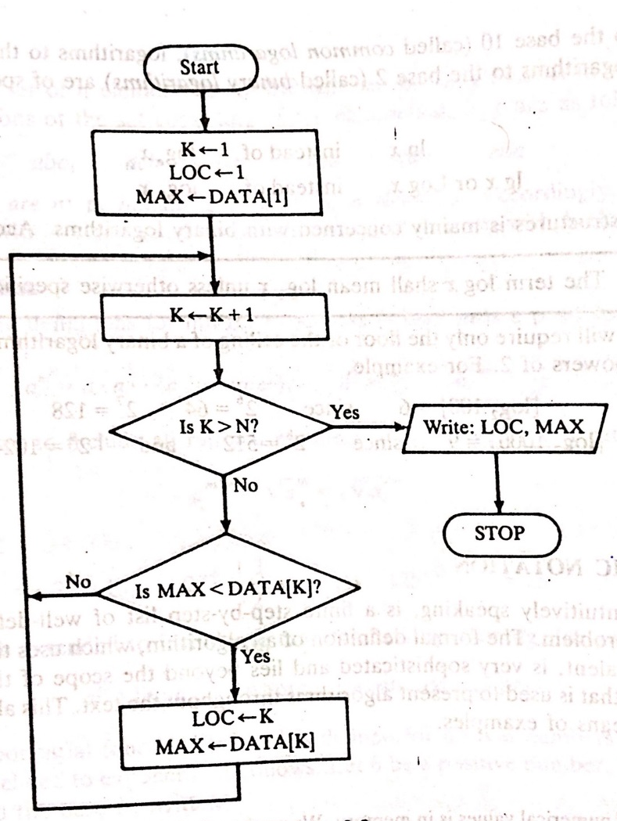
Flowcharts
CSE 2103

Slide 48
CSE 2103
Understanding Time Complexity
Understanding Time Complexity

Slide 49

CSE 2103
“IN Computer Science, time complexity describes the amount of time that takes to run an algorithm or Code.”

Slide 50

How to calculate Time Complexity ?
CSE 2103
“Time complexity is calculated by counting the Number of Operation , which takes a fixed amount of time to perform.”

Slide 51

Big O Notation
CSE 2103
“Big O notation is a mathematical notation that describes the limiting behavior of a function when the argument tends towards a particular value or infinity.”

Slide 52
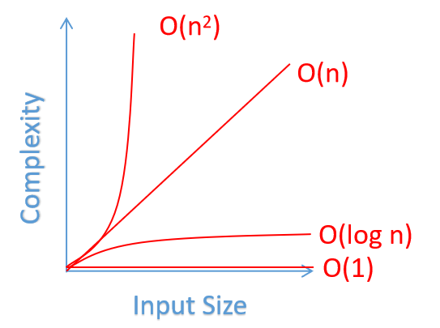
Common Time Complexity
CSE 2103
O(1) Constant Time complexity
O(N) Linear Time Complexity
O(N^2) Quadratic Time Complexity
O(N log N) Logarithmic Time Complexity

Slide 53
Constant Time Complexity-O(1)
CSE 2103
#include <iostream>
using namespace std;
int main() {
int a,b;
cin >> a >> b;
//O(1+1)=O(1) constant operation.
int sum = a+b;
cout<< sum <<endl;
return 0;
}
Input ( in single operation)
Output (in single operation)

Slide 54
Linear Time Complexity - O(N)
CSE 2103
#include<bits/stdc++.h>
using namespace std;
int main()
{
int t;
cin >> t;
int n;
cin >> n;
int arr[n];
for(int i=0;i<n;i++){
cin >> arr[i];
} // O(N) *here N is Number of element
sort(arr,arr+n);
for(int i=0;i<n;i++){
cout << i << " ";
} // O(N) *here N is Number of element
cout << endl;
}
While doing operation with Single for or while loop.
Total Complexity( O(N) )
In 1 Sec 1e7 Or maximum 1e8 Iteration can be done.

Slide 55
Quadratic Time Complexity – O(N^2)
CSE 2103
#include<bits/stdc++.h>
using namespace std;
int main()
{
int n;
cin >> n;
int arr[n];
for(int i=0;i<n;i++) cin >> arr[i];
//Bubble sort
for( int i = 0; i < n; i++ )
{
for(int j = 0; j < (n-i-1); j++) {
if(arr[j] > arr[j+1]){
swap( arr[j] , arr[j+1] );
}
}
}
for(auto u : arr){
cout << u << " ";
}
cout << endl;
}
“If Two nested loop used and iterate through all the elements. Then complexity is O(n^2).”
Explanation : iteration for the inner loop : (n-1)*(n-2)……*2*1.
So the result is n*(n-1) which is O(n^2).

Slide 56
Logarithmic Time Complexity – O(log N)
CSE 2103
int main()
{ // Binary Search
int n , v[n]; cin >> n;
for(int i=0; i<n; i++){
cin >> v[i];
}
int lo=0,hi=n-1,mid,fnd;
cin >> fnd;
while(hi>=lo){
mid=(hi+lo)/2;
if(v[mid] == fnd) {
cout << mid << endl;
break;
}
if(v[mid] <= fnd){
lo=mid+1;
}
else
{
hi = mid-1;
}
}
}
Per Operation mid divides into half Value. That means
n/2 + n/4 + n/8 + n/16 + ……..
= n (1/2 + 1/4 + 1/8 + …….. )
= log(n)) // log₂(y) = x, 2^x = y;
So, Time Complexity of Binary search is O(log(n))

